Slide 1

Chapter 1 The Basics
How to Use MATLAB/SIMULINK
09 September 2026
By Nathaniel Tyler

Slide 2


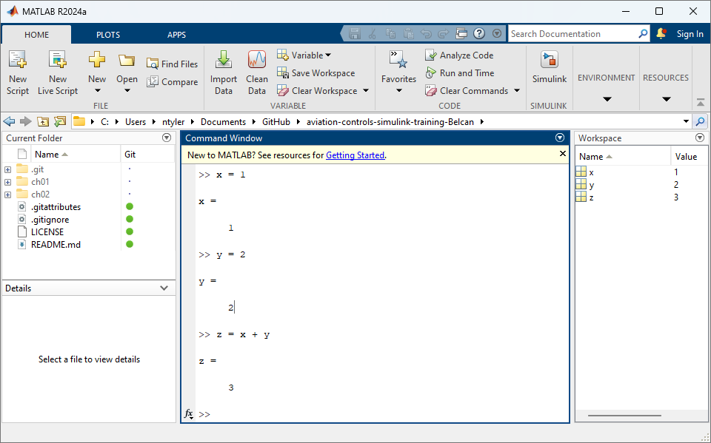
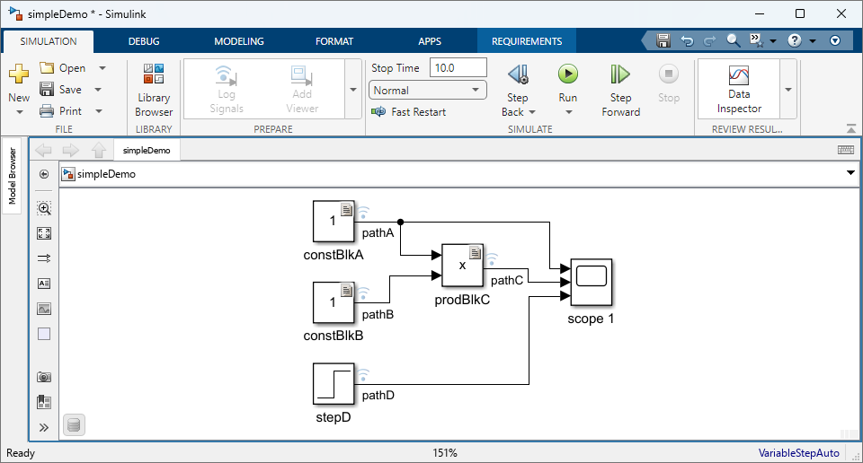
What is MATLAB and Simulink? MATLAB and Simulink provide a unified environment for model-based development, simulation, and verification of complex engineering systems.
What is MATLAB and Simulink?
MATLAB
Simulink
Numerical computing, analysis, and algorithm development.
Graphical modeling and simulation of dynamic systems.

Slide 3
What are some useful commands for MATLAB and Simulink?
What are some useful commands for MATLAB and Simulink?
MATLAB
Simulink
What are some useful commands?
What are some useful shortcuts?
Clear workspace clear
Clean window clc
Cancel Action CTRL + C
Save CTRL + S
Cancel Action CTRL + C
Compile CTRL + D
Build CTRL + B
Run Sim CTRL + T

Slide 4
Success looks like knowing how to …
What does success look like?
Open MATLAB & SIMULINK
Create a new Simulink Model
Use blocks
Run a simulation
Use Data inspector
Use Model Explorer
Use Requirements editor

Slide 5

simpleDemo.slx Note: Scopes are not used in Rolls Royce models. I ONLY used a scope because it was the first sink I thought of for this Chapter 1 walkthrough.
Final Model(s)

Slide 6
How to Download the Git Repo

Slide 7
Git Hub Training Repo
How to Download the Git Repo
Git Hub Webpage
ntylerbelcan/aviation-controls-simulink-training-Belcan
Ensure you are in a folder called “GitHub” before your run either of the following commands:
In Git Bash / Terminal you can run
git clone https://github.com/ntylerbelcan/aviation-controls-simulink-training-Belcan.git
OR
In MATLAB
You can clone directly from the MATLAB command window:MATLAB
system('git clone https://github.com/ntylerbelcan/aviation-controls-simulink-training-Belcan.git')

Slide 8
How to Open MATLAB & SIMULINK

Slide 9
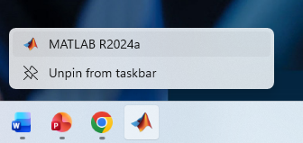
Open MATLAB
How to Open MATLAB & SIMULINK

Slide 10
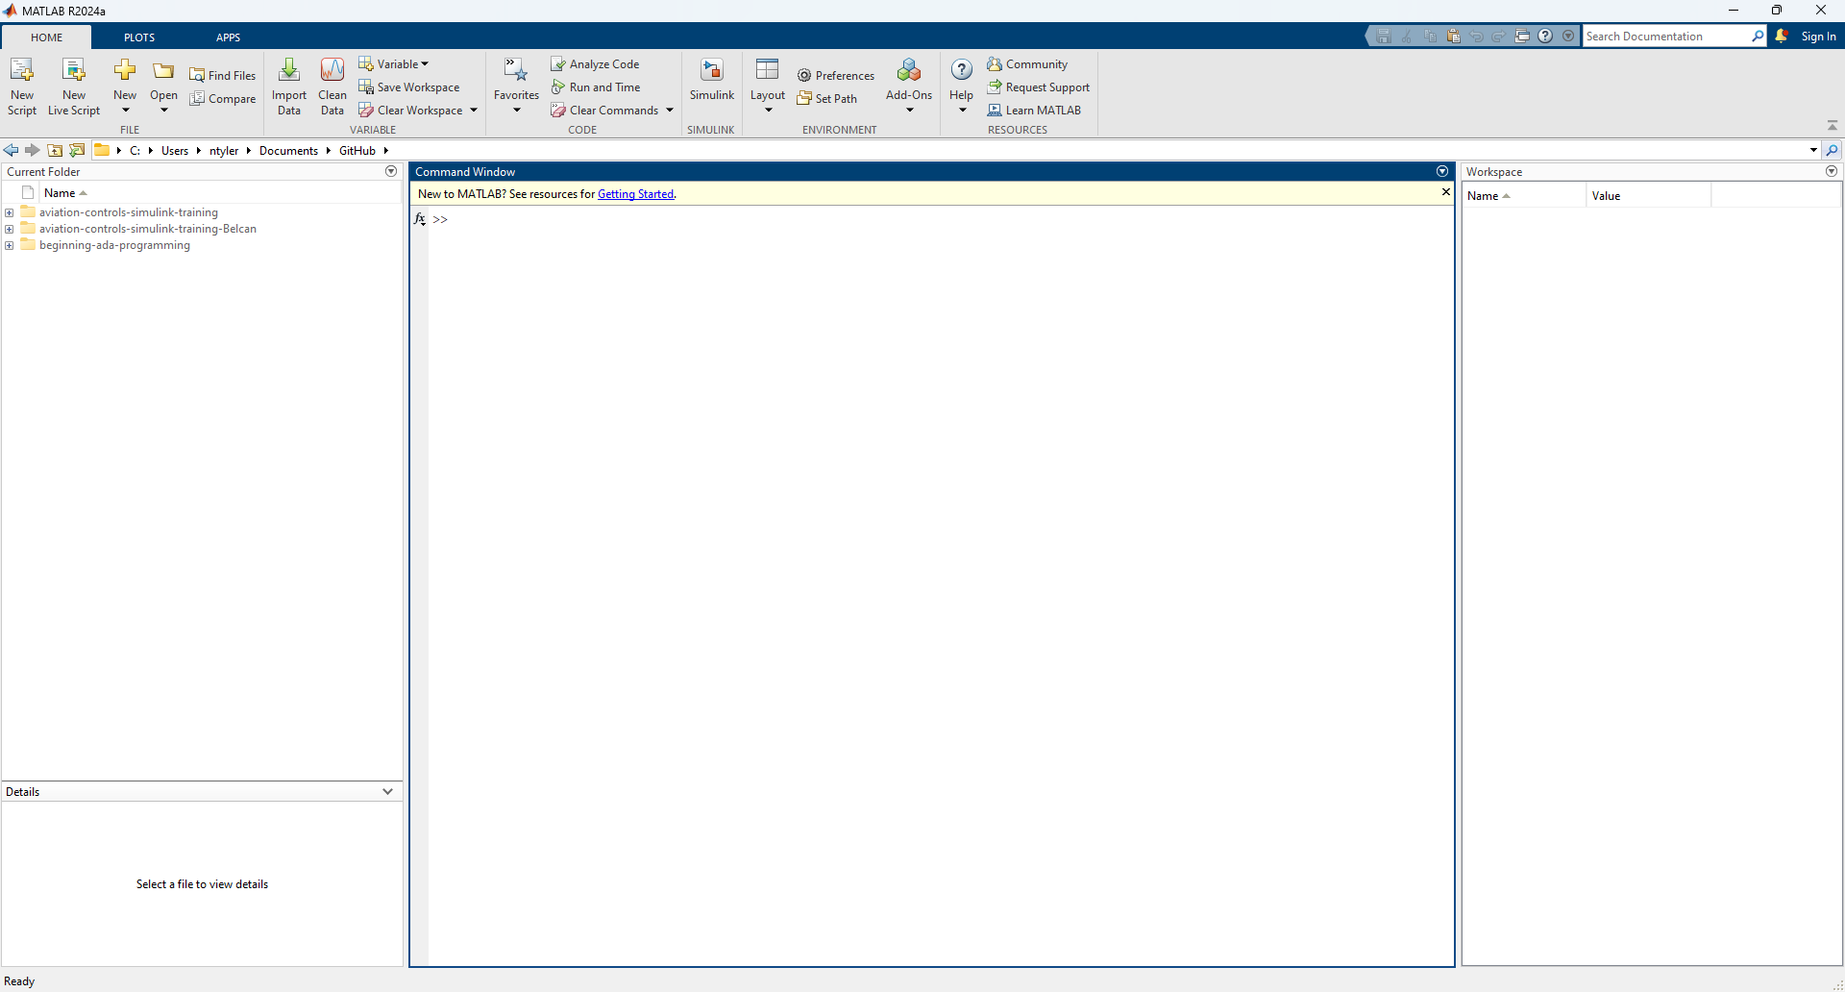
Review the MATLAB Window Layout
How to Open MATLAB & SIMULINK

Slide 11
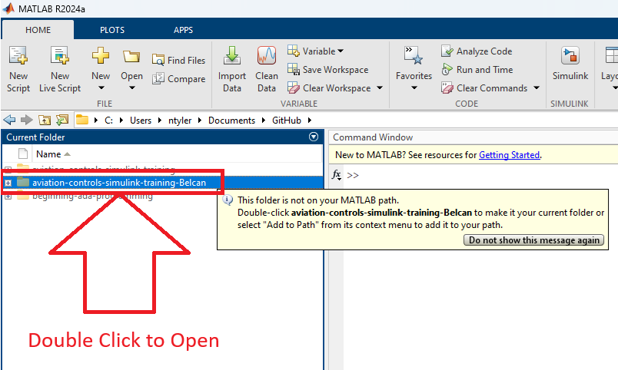
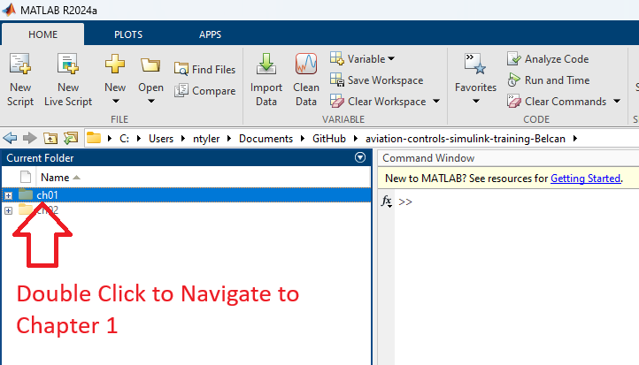
Navigate to training folder
How to Open MATLAB & SIMULINK
Step 1. Navigate to training folder
Step 2. Navigate to Chapter 1 folder

Slide 12
How to Create a new Simulink Model

Slide 13
Detailed Success in this section looks like knowing how to …
How to Create a new Simulink Model
Create a new Simulink Model
Creating File (slx) Create / Rename / Open

Slide 14
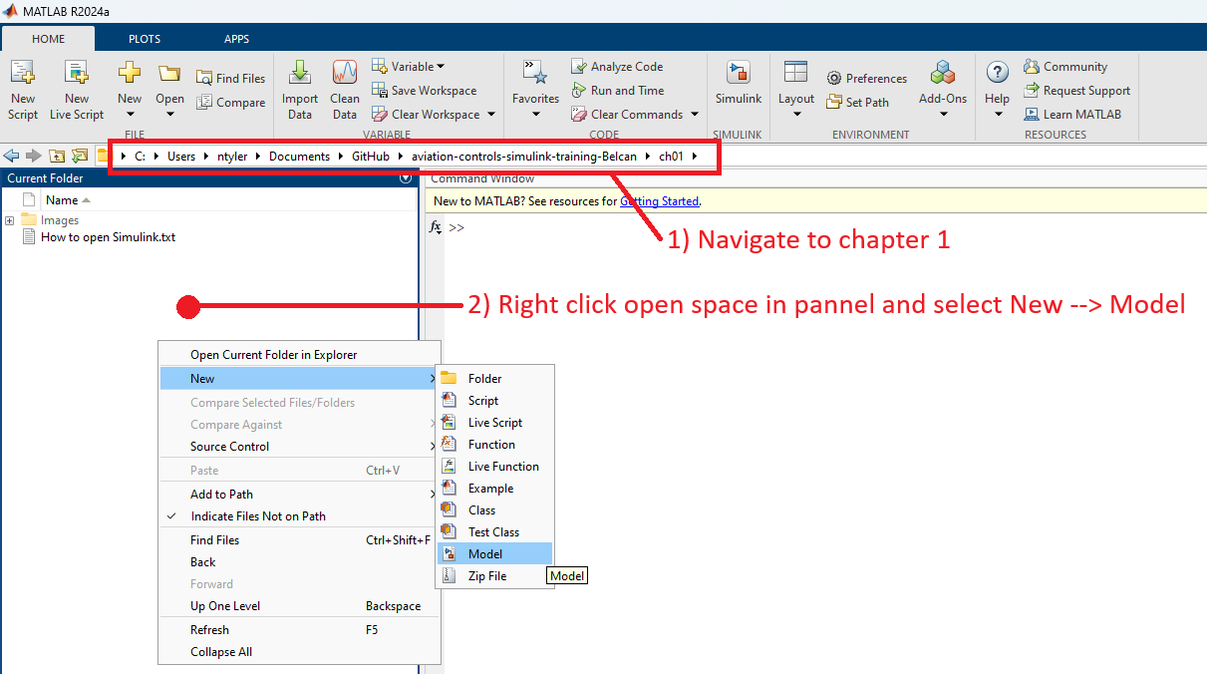
Navigate to training folder & create Simulink Model
How to Create a new Simulink Model

Slide 15
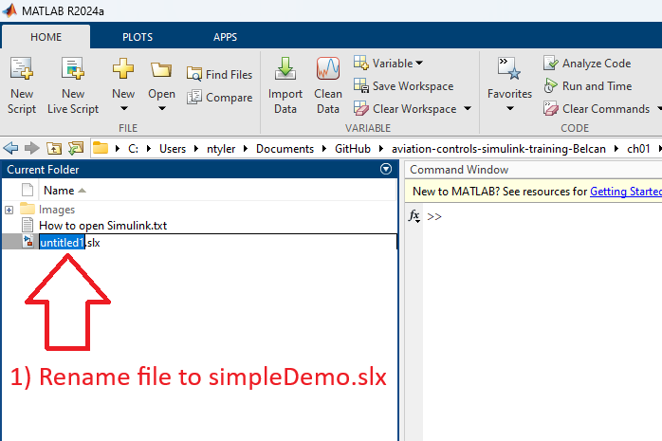
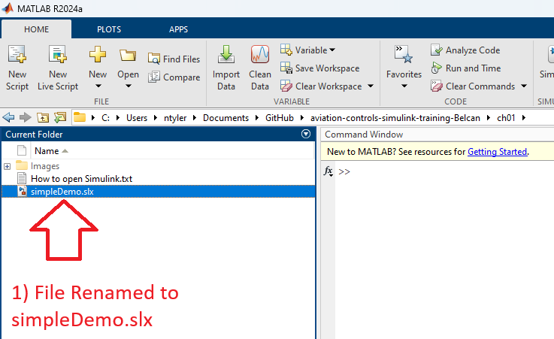
Rename Simulink File
How to Create a new Simulink Model
Step 1. Right click new file
Step 2. Rename and Press Enter

Slide 16
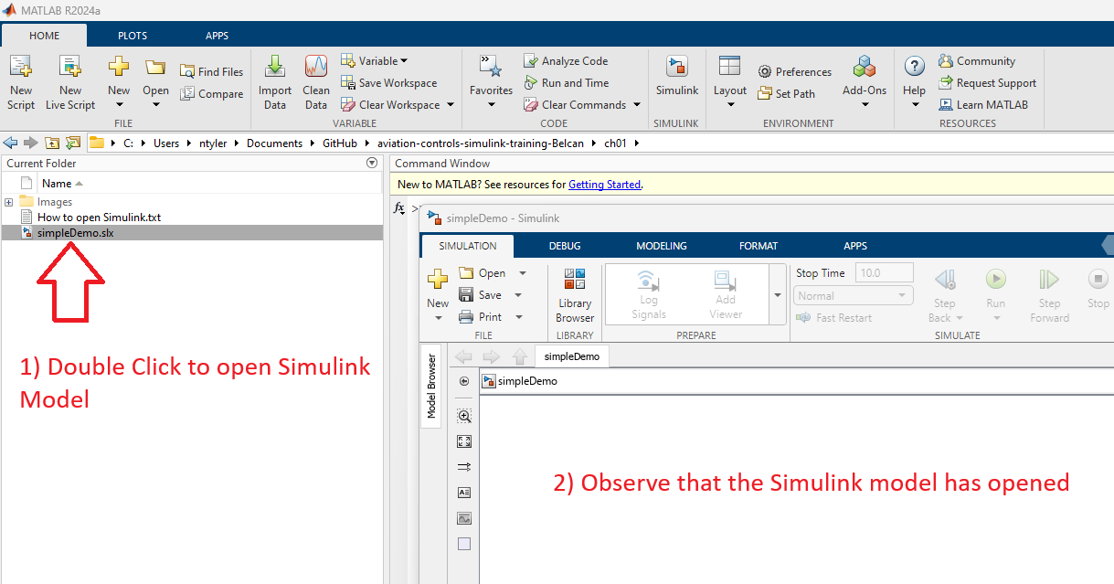
Open Simulink Model
How to Create a new Simulink Model

Slide 17
How to Use blocks (Part 1)

Slide 18
Detailed Success in this section looks like knowing how to …
How to Use blocks (Part 1)
Use blocks
Accessing Library Browser Open / Find Blocks
Blocks Add / Edit / Label
Model Fit Contents to Window
Lines Create / Edit / Format / Label / Data log

Slide 19
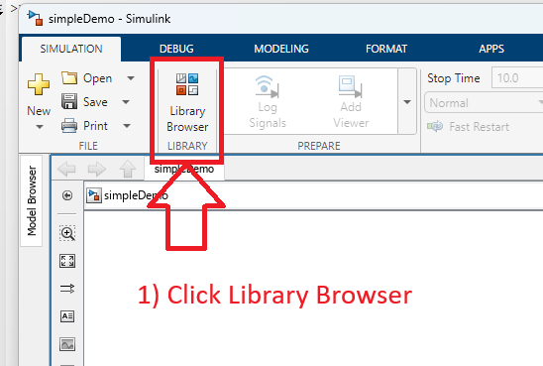
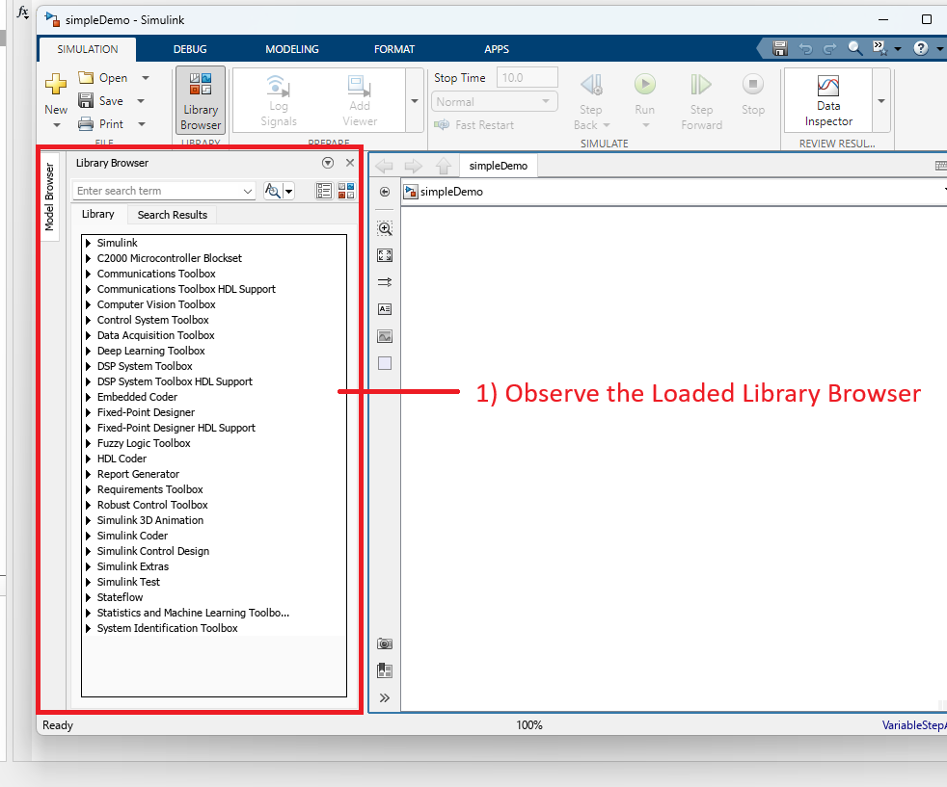
Open Library Browser (Part 1)
How to Use blocks (Part 1)
Step 1. Click Library Browser
Step 2. Observe loaded library browser window

Slide 20
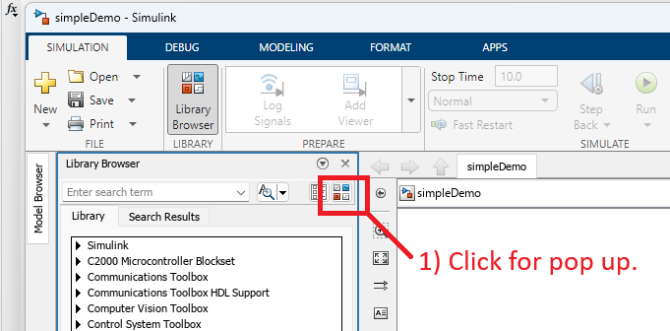
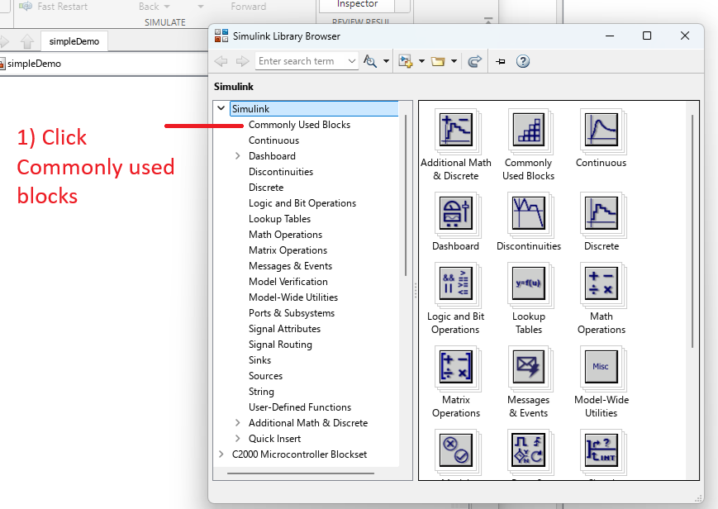
Open Library Browser (Part 2)
How to Use blocks (Part 1)
Step 3. Click Icon
Step 4. Review Common Blocks

Slide 21
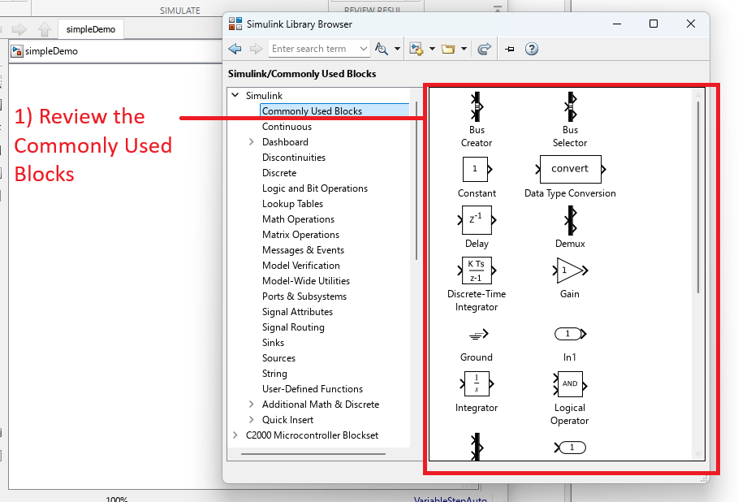
Open Library Browser (Part 3)
How to Use blocks (Part 1)
Step 5. Review Common Blocks

Slide 22
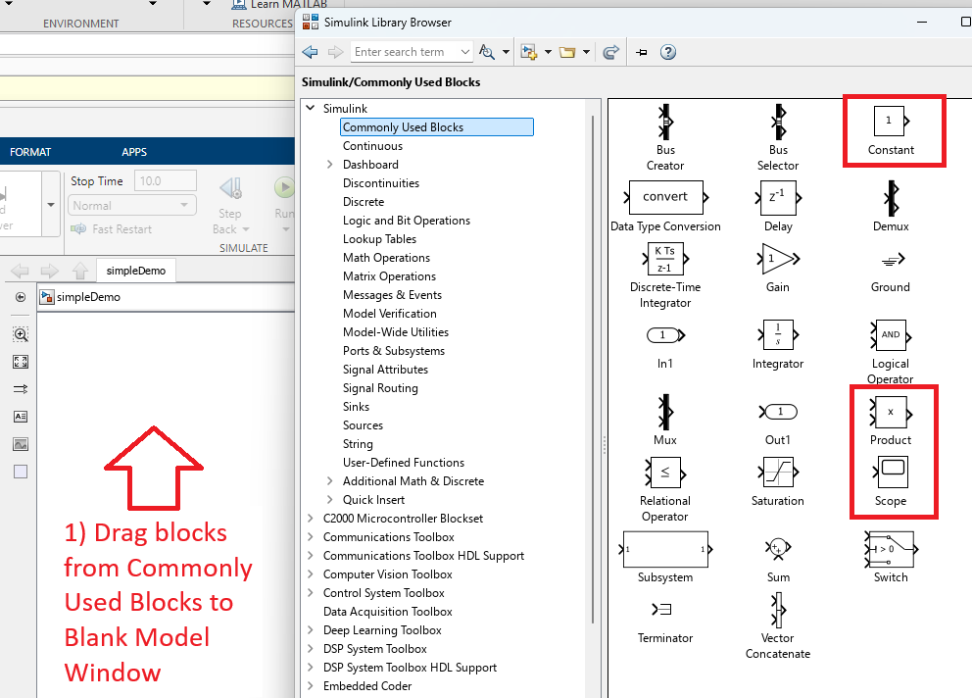
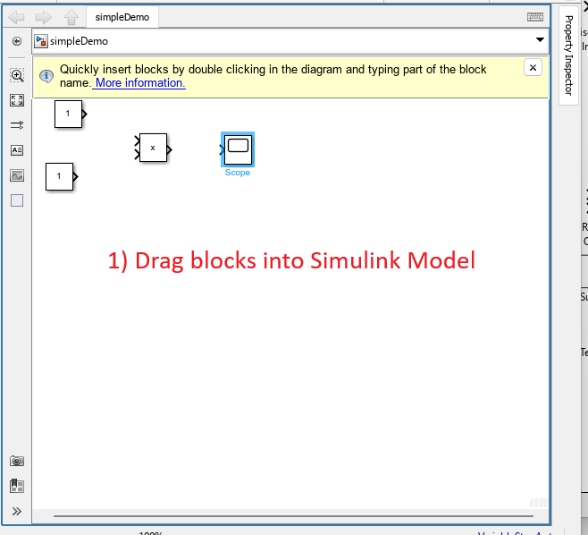
Add Blocks to Simulink Model (Method 1)
How to Use blocks (Part 1)
Step 1. Drag Blocks from Library to Simulink model window
Step 2. Observe the Simulink model after Drag and Drop

Slide 23
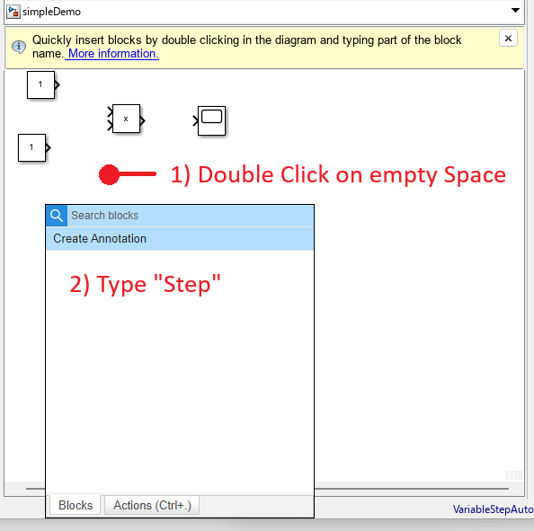
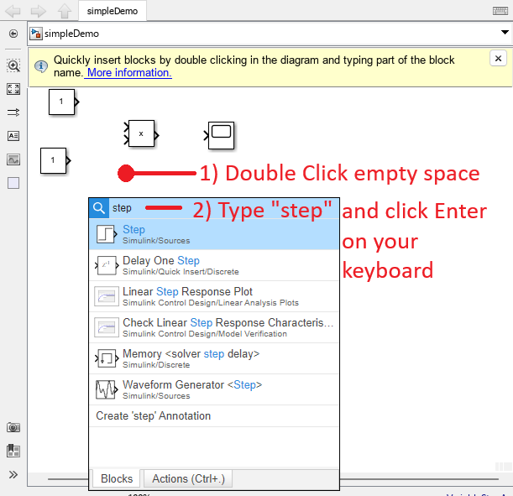
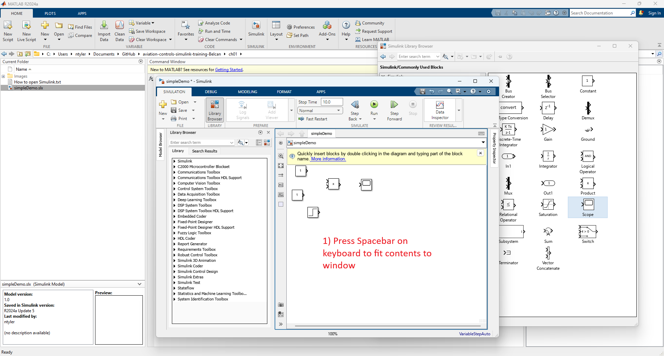
Add Blocks to Simulink Model (Method 2)
How to Use blocks (Part 1)
Step 1. Double Click on Empty Space
Step 2. Type “step” and press enter
Step 3. Observe Newly added block

Slide 24
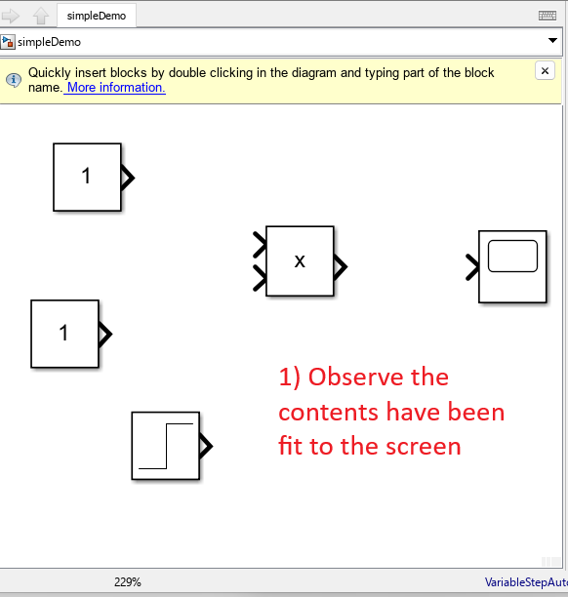
Fit Contents to Window
How to Use blocks (Part 1)
Step 1. Click Simulink Model and press spacebar
Step 2. Observe the content has been fit to the screen.

Slide 25
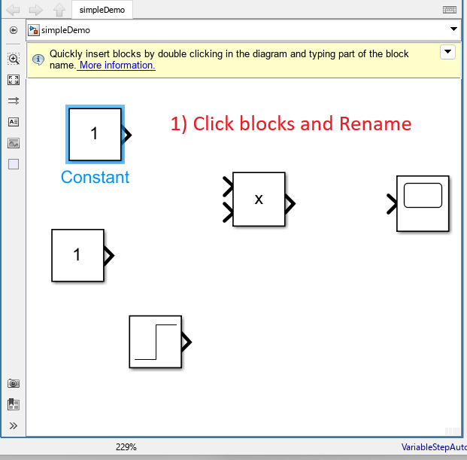
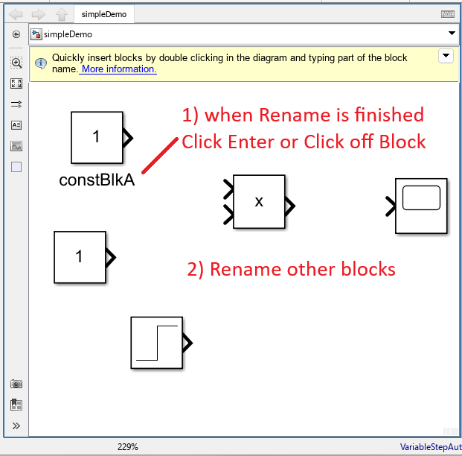
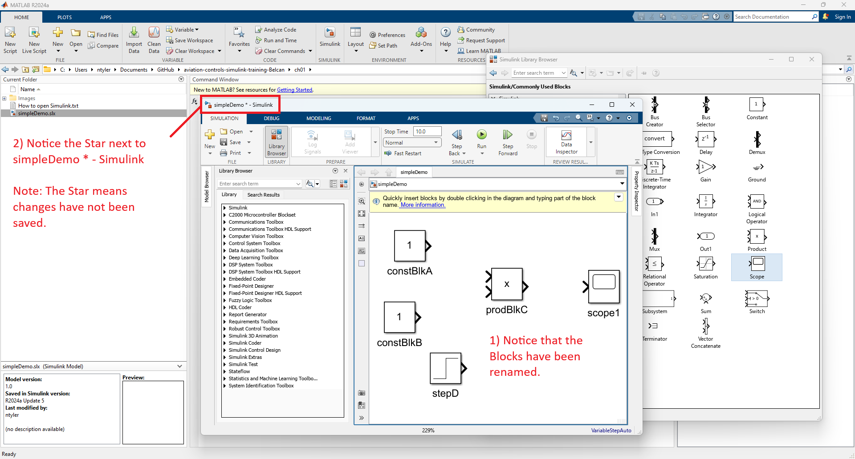
Rename Blocks
How to Use blocks (Part 1)
Step 1. Click the block & then click the blue text
Step 2. Rename Block and then press enter or click off the block
Step 3. Observe Newly added block

Slide 26
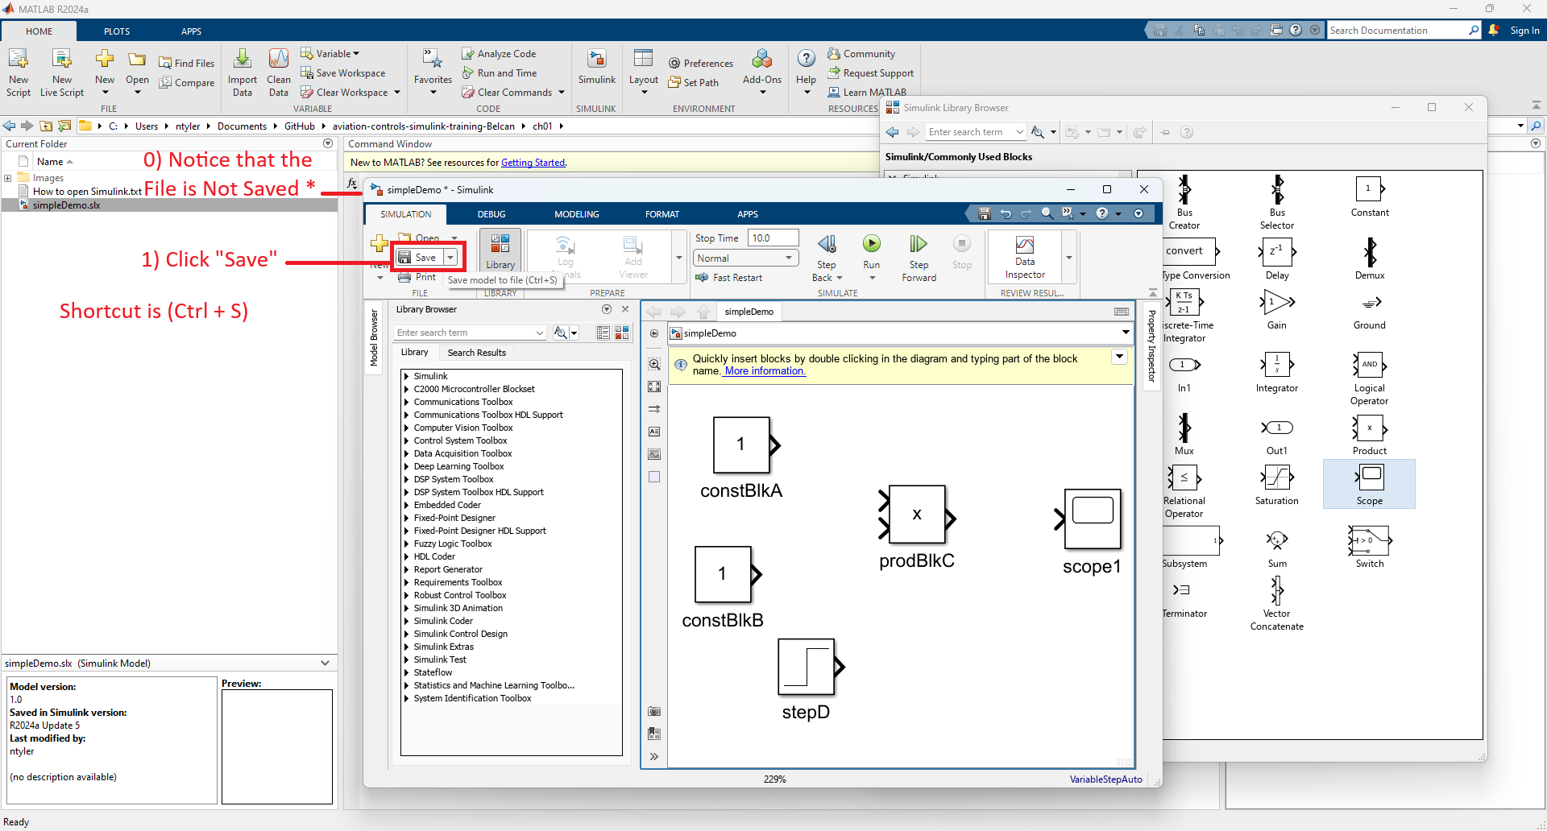
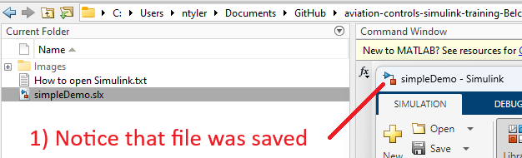

Save Simulink Model File
How to Use blocks (Part 1)
Step 1. Notice the File is unsaved
Step 2. Press Save Or CTRL+S
Step 3. Observe Model has been renamed

Slide 27
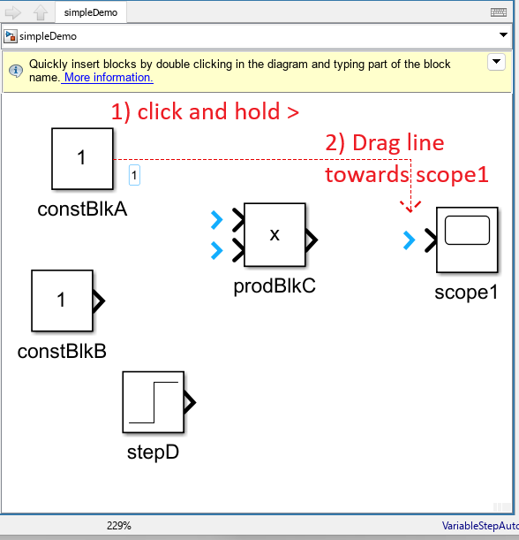
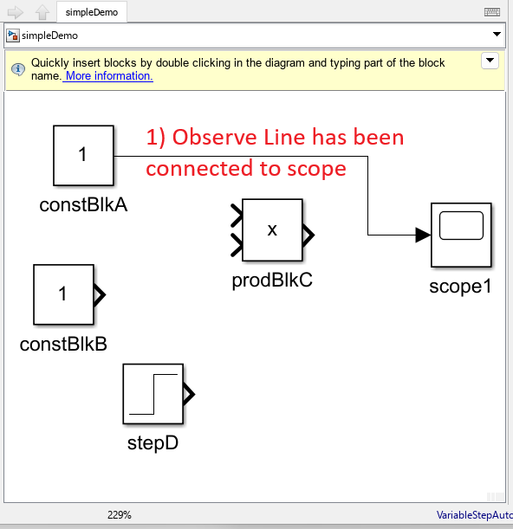
Connect Lines / Drag Line (Part 1)
How to Use blocks (Part 1)
Step 1. Connect Line
From source block to destination block
Step 2. Observe Blocks have been connected

Slide 28
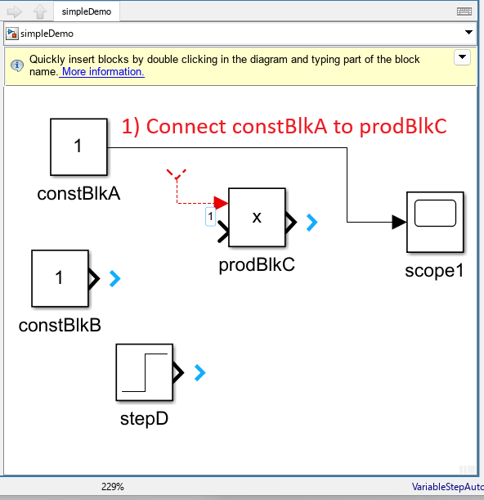
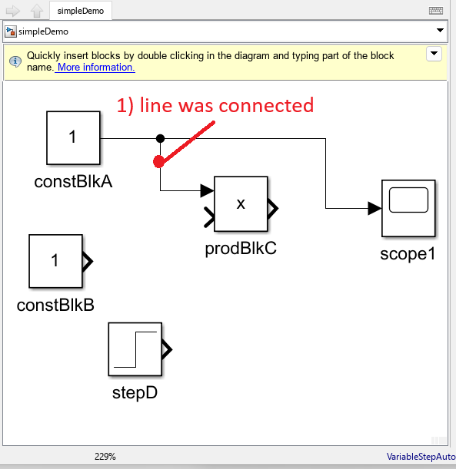
Connect Lines / Drag Line (Part 2)
How to Use blocks (Part 1)
Step 1. Connect Line
From destination block to source block
Step 2. Observe Blocks have been connected

Slide 29
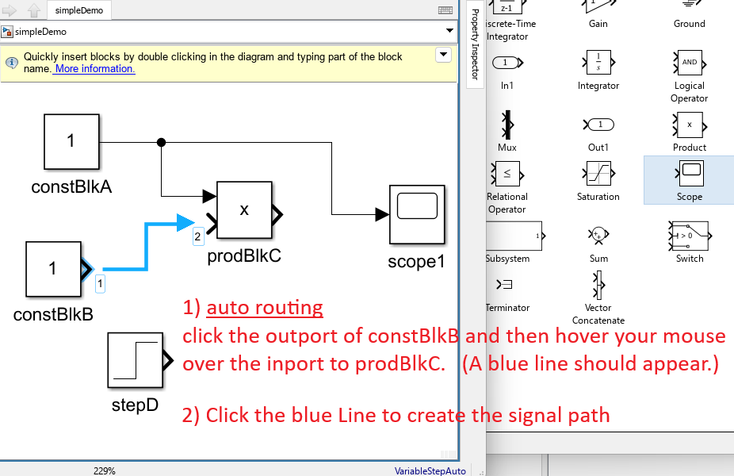
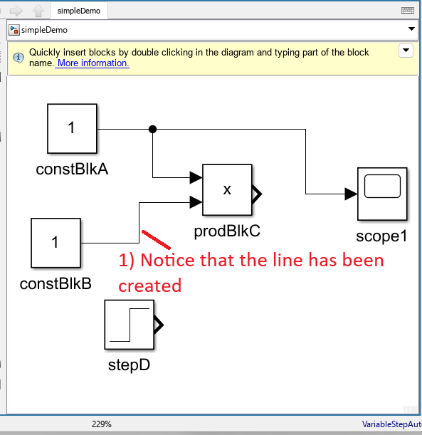
Connect Lines / Auto Routing
How to Use blocks (Part 1)
Step 1. Connect Line
Step 2. Observe Blocks have been connected

Slide 30
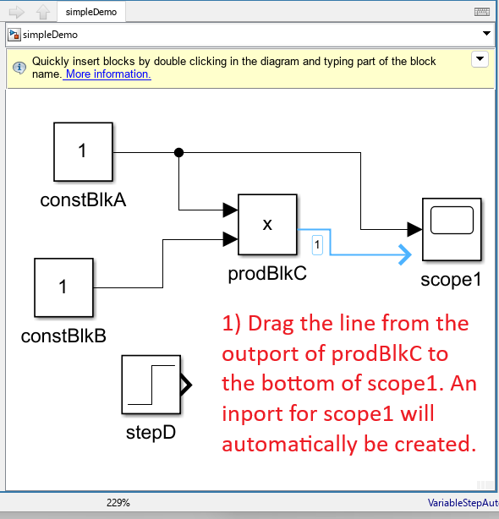
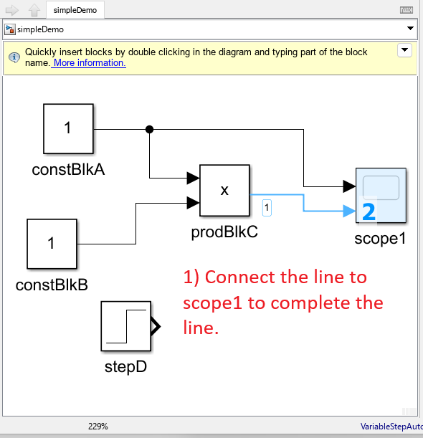
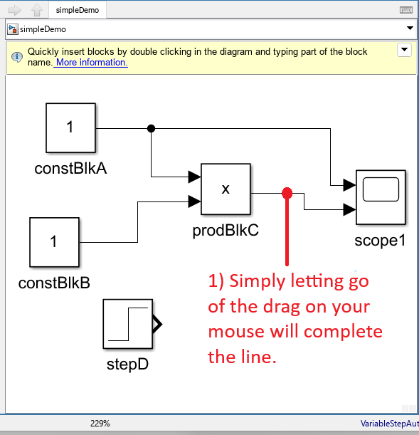
Connect Lines / Drag Line / Create Inport
How to Use blocks (Part 1)
Step 1. Connect Line
From destination block to source block
Step 2. Create New Inport
Step 3. Observe Blocks have been connected

Slide 31
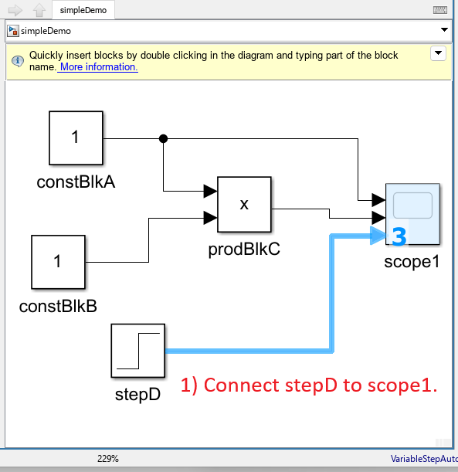
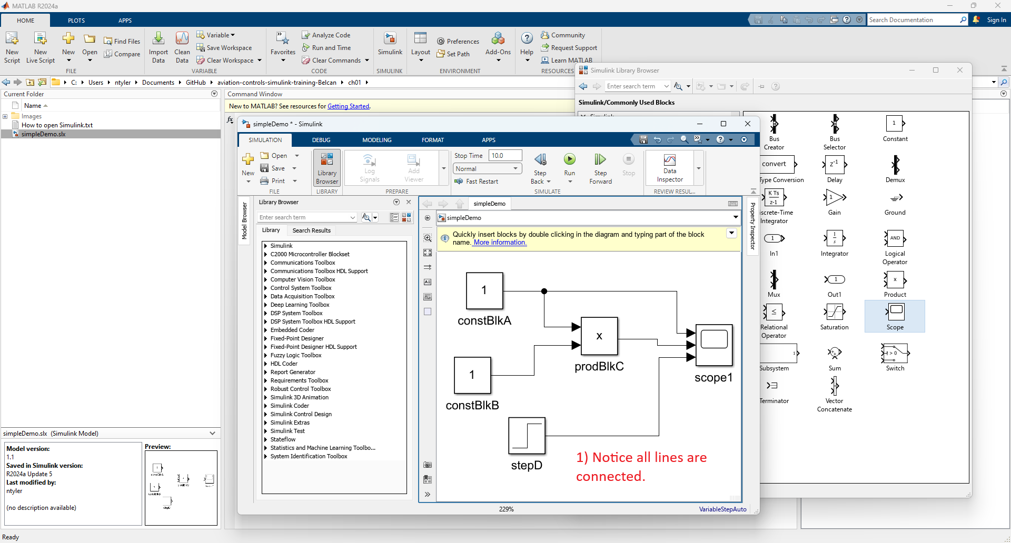
Connect Lines / Drag Line / Create Inport
How to Use blocks (Part 1)
Step 1. Create New Inport
Step 2. Observe Blocks have been connected

Slide 32
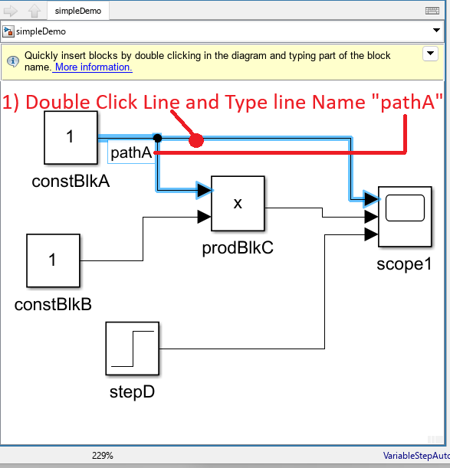
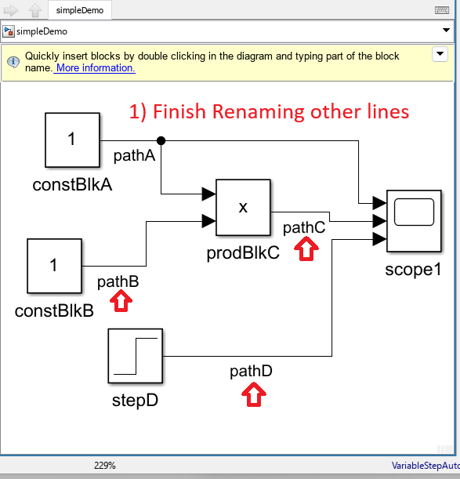
Rename Signals
How to Use blocks (Part 1)
Step 1. Before Renaming Signals
Step 2. Double Click Line and Rename the Signal
Step 3. Rename all other Signals

Slide 33
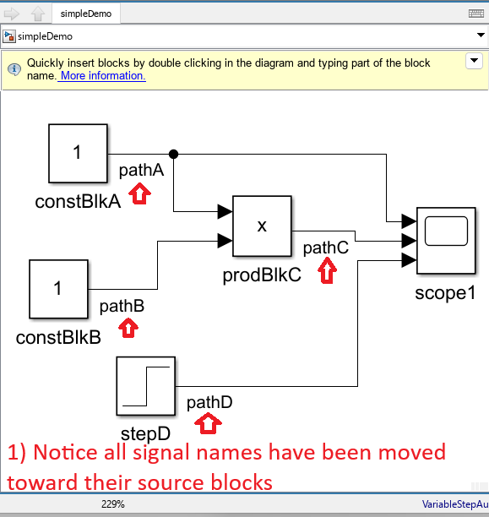
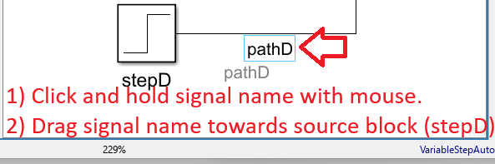
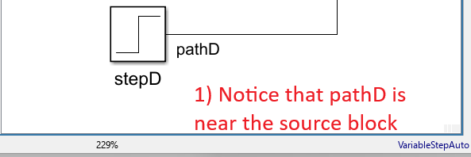
Move Signals
How to Use blocks (Part 1)
Step 1. Drag and drop the signal name next to the source block
Step 2. Observe signal name was moved next to source block
Step 3. Move other signal names towards their source blocks

Slide 34
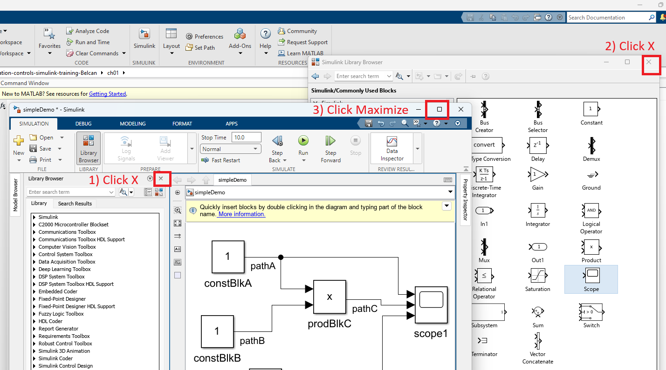
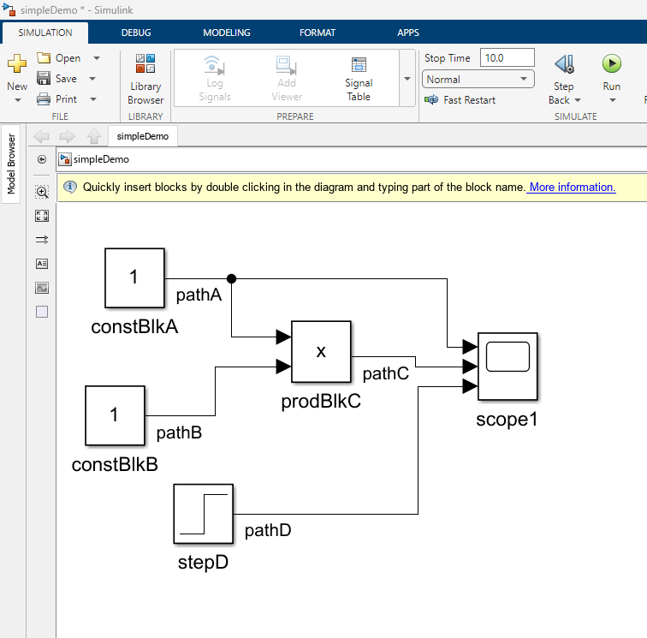
Clean up Window
How to Use blocks (Part 1)
Step 1. Clean up the window
Step 2. Observe cleaned up window

Slide 35
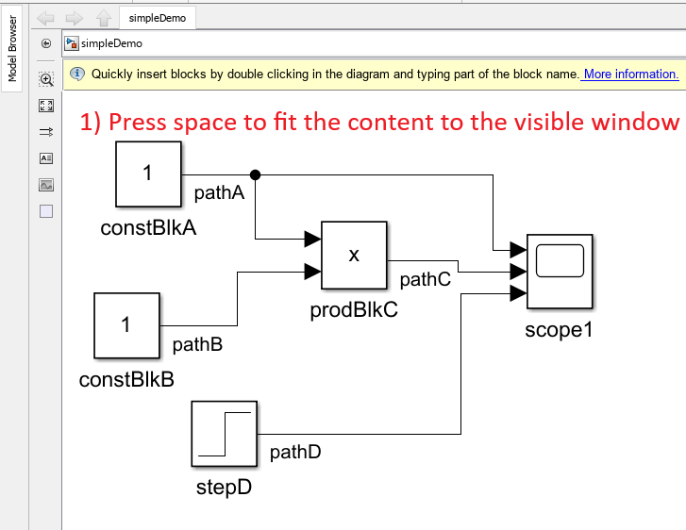
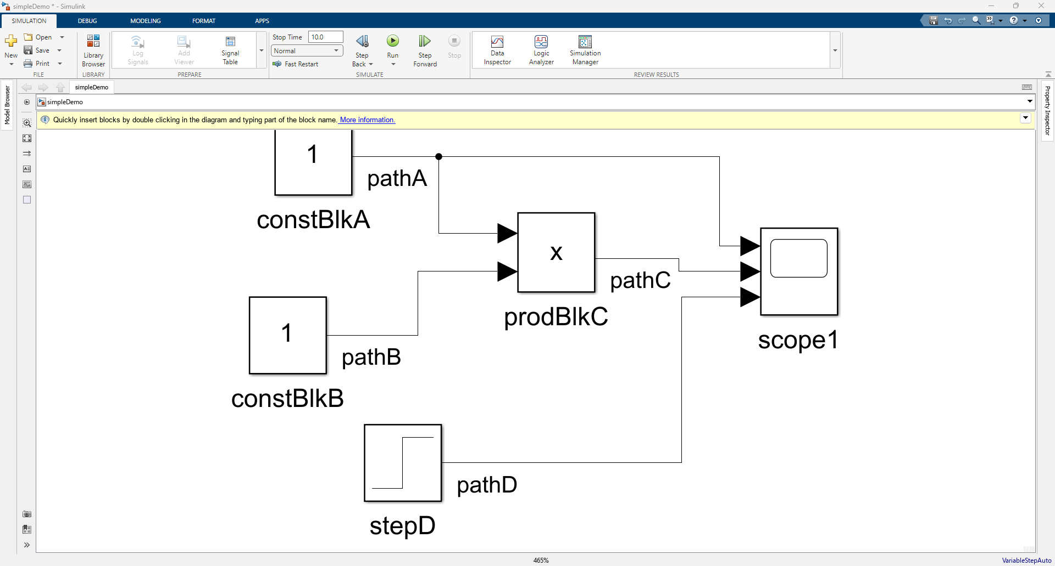
Fit Contents to Window
How to Use blocks (Part 1)
Step 1. Click Simulink Model and press space
Step 2. Observe the content has been fit to the screen.

Slide 36
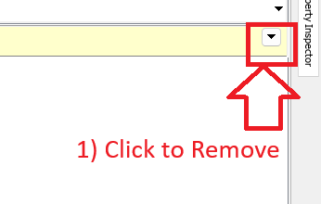
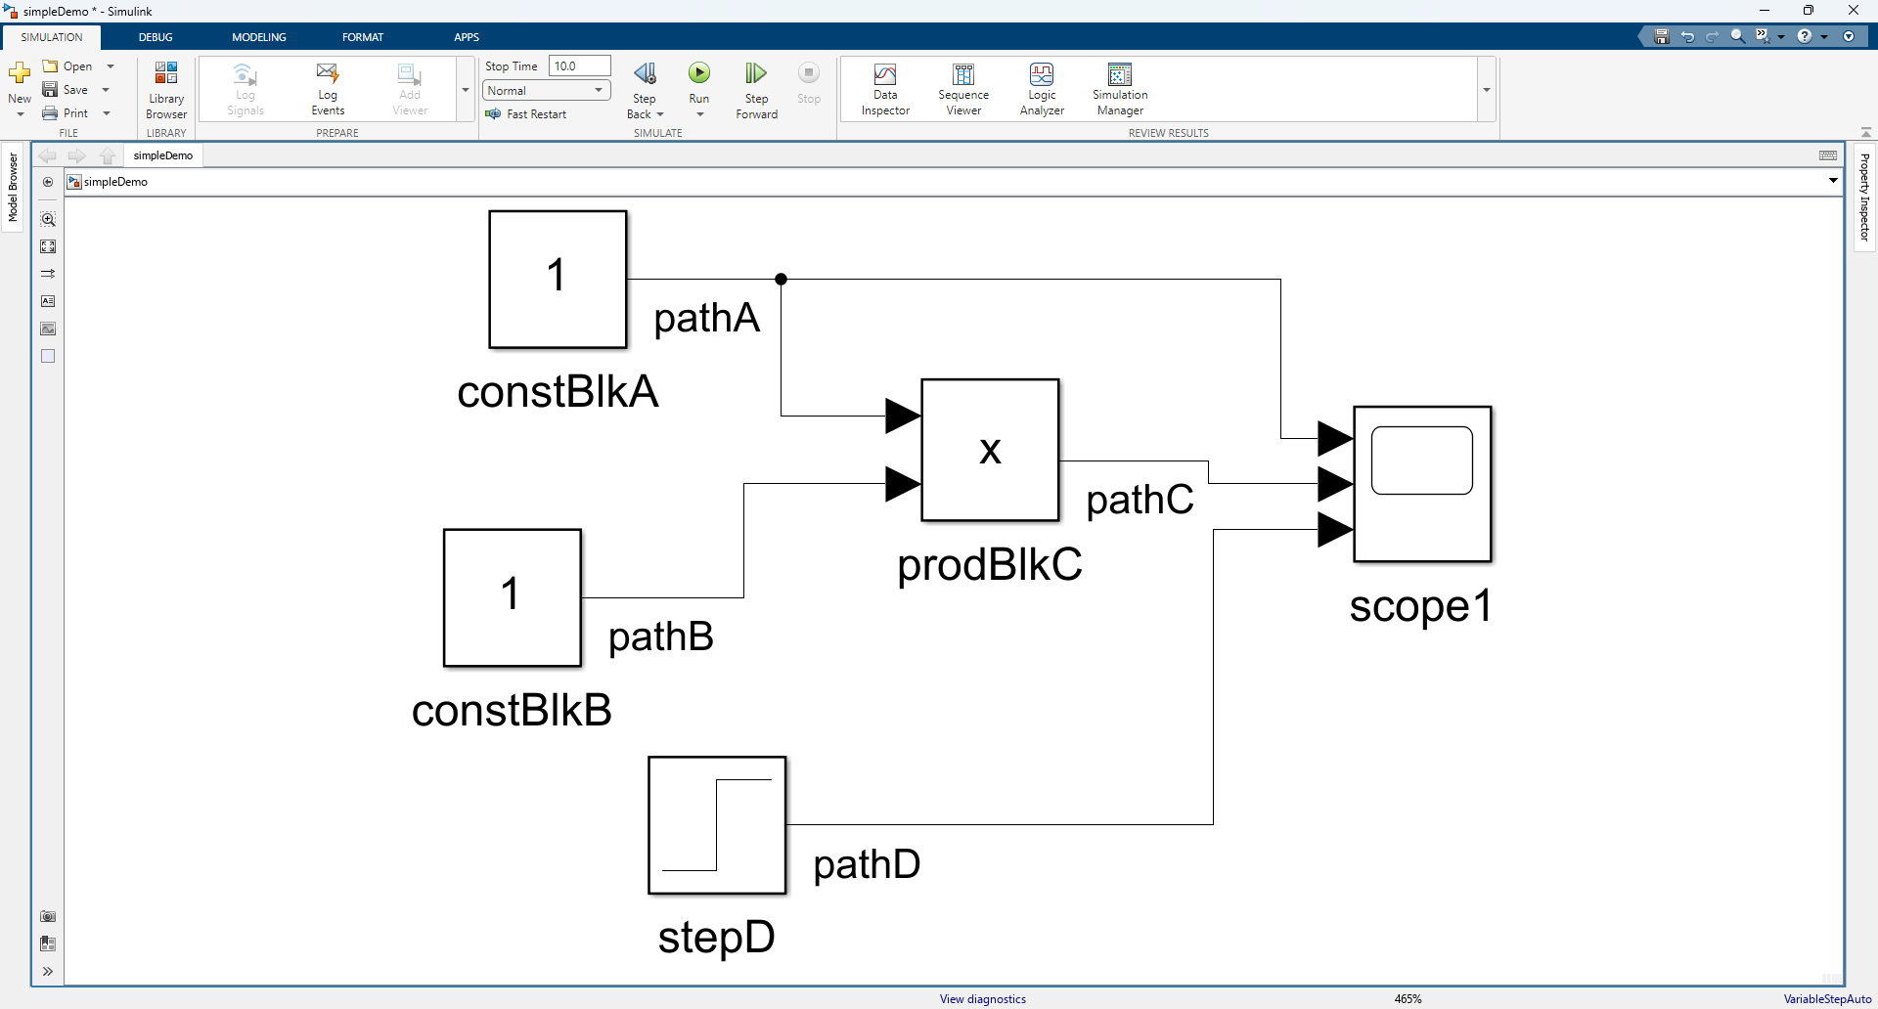
Remove Yellow Bar
How to Use blocks (Part 1)
Step 1. Click the down arrow and remove bar
Step 2. Observe yellow bar has been removed.

Slide 37
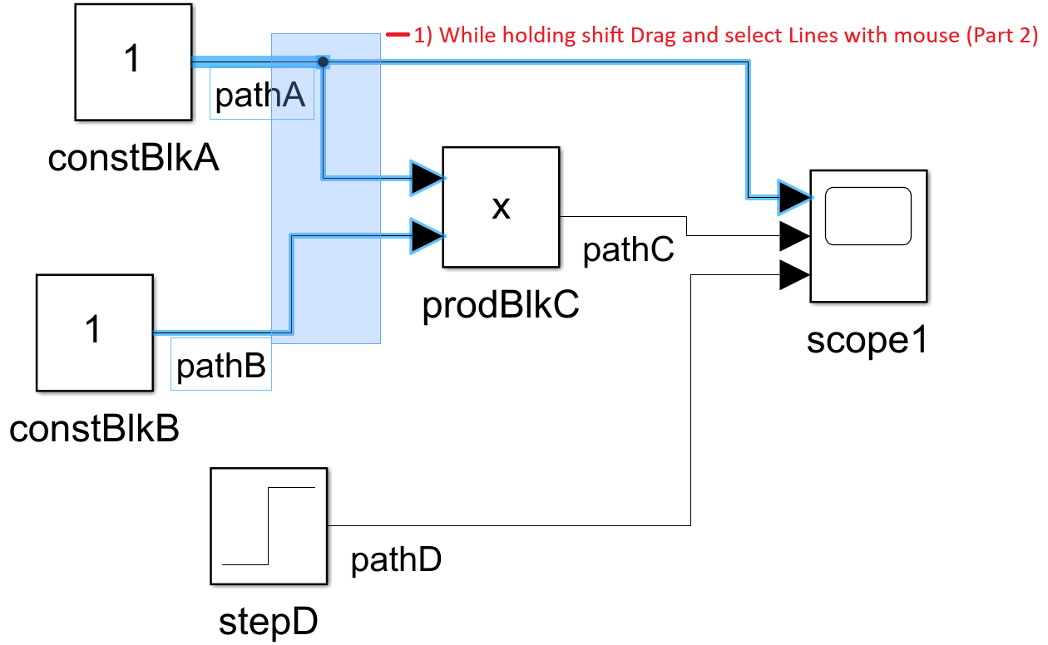
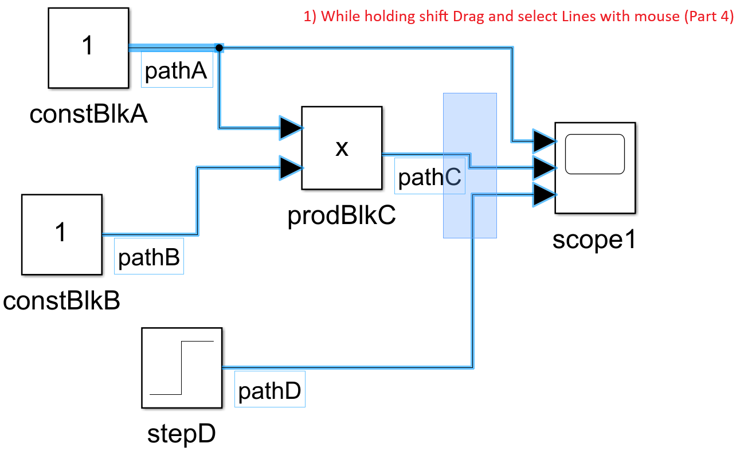
Select Lines Note: Do Not Select any blocks
How to Use blocks (Part 1)
Step 1. Hold SHIFT & drag cursor to select lines.
Step 2. Select other Lines

Slide 38

Signal Logging (Part 1)
How to Use blocks (Part 1)
Step 1. Click “Signal” Tab

Slide 39


Signal Logging (Part 2)
How to Use blocks (Part 1)
Step 1. Click Test Point
Step 2. Click Log Signals

Slide 40
How to Run a simulation

Slide 41
Detailed Success in this section looks like knowing how to …
How to Run a simulation
Run a simulation
Run Shortcut (CTRL+T)
Stop Time Default Value is 10 sec

Slide 42

Run Simulation
How to Run a simulation
Step 1. Click Run

Slide 43
How to Use Data inspector

Slide 44
Detailed Success in this section looks like knowing how to …
How to Use Data inspector
Use Data inspector
Graph Graph Data / Edit Grid / Use Cursors
Stop Time Default Value is 10 sec

Slide 45



Open Data Inspector Note: Simulation must be run prior to opening Data inspector to observe raw values.
How to Use Data inspector
Step 1. Observe Logged Signals
Step 2. Click “Data Inspector”
Step 3. Observe the Data Inspector

Slide 46

Add 1 Signal to Chart + Stop Time Overview
How to Use Data inspector
Step 1. Check box to add signal to data inspector chart
Note: The only reason we have 10 seconds of data is because the stop time is currently set for 10 seconds.
Increase the stop time to obtain more data.

Slide 47


Edit Grid Layout
How to Use Data inspector
Step 1. Click Grid Icon & update Row value to 4

Slide 48




Add Signal(s) to Chart
How to Use Data inspector
Step 1. Add Signals to Chart
Step 2. Add Cursors to Chart
Step 3. Close Data inspector
Step 4. Save

Slide 49
How to Use blocks (Part 2)

Slide 50
Detailed Success in this section looks like knowing how to …
How to Use blocks (Part 2)
Use blocks
Blocks Format
Signal Attributes View / Edit / Property Inspector

Slide 51



Formatting Blocks – Align Left Note: both lines and blocks may be selected for this section Note: align commands will only affect the placement of the blocks
How to Use blocks (Part 2)
Step 1. Select blocks & then click “Format” tab
Step 2. Click Align Right
Step 3. Observe the blocks have been aligned

Slide 52


Show Property Inspector (Method 1) Note: This method will force property Inspector to activate
How to Use blocks (Part 2)
Step 1. Click “MODELING” Tab and expand options
Step 2. Click Property Inspector

Slide 53


Show Property Inspector (Method 2) Note: This is my preferred method
How to Use blocks (Part 2)
Step 1. Click Property Inspector
Step 2. Click Down Arrow and then Click Restore

Slide 54


Update Signal Attributes (P1)
How to Use blocks (Part 2)
Step 1. Click Block + Expand & Edit Signal Attributes
Step 2. Observe updated Attributes

Slide 55


Update Signal Attributes (P1)
How to Use blocks (Part 2)
Step 1. Click Block + Expand & Edit Signal Attributes
Step 2. Observe updated Attributes

Slide 56


Save Changes Note: The star * was removed after the save took place
How to Use blocks (Part 2)
Step 1. Click Save
Step 2. Observe document has been saved.

Slide 57
How to Use Model Explorer

Slide 58
Detailed Success in this section looks like knowing how to …
How to Use Model Explorer
Use Model Explorer
Data Dictionary (sldd) Create / Edit
Signal Attributes View / Edit / Property Inspector

Slide 59

Open Model Explorer
How to Use Model Explorer
Step 1. Click “MODELING” Tab and Click “Model Explorer”
Step 2. Observe Model Explorer Window

Slide 60

Create Data Dictionary File (.sldd) Note: In later chapters I deep dive the data dictionary. For now, I will only cover high level topics.
How to Use Model Explorer
Step 1. Drill Down to “External Data” and then Click “New”

Slide 61


Create Data Dictionary File (.sldd)
How to Use Model Explorer
Step 1. Save file as “sampleDD”
Step 2) Apply Changes

Slide 62



Open Design Data
How to Use Model Explorer
Step 1. Click “sampleDD”
Step 2. Drill down to Design Data
Step 3. Observe Design Data
1) Expand
2) Click

Slide 63

Create Simulink Signal
How to Use Model Explorer
Step 1. Click “Simulink Signal”
Note: This will add a new signal to your data inspector.

Slide 64

Update Sig (Before Changes)
How to Use Model Explorer
Step 1. Update Sig Attributes
Step 2. Update Signal Name and then apply changes

Slide 65

Update Sig (After Changes)
How to Use Model Explorer
Step 1. Update Sig Attributes
Step 2. Update Signal Name
Step 3. Click Apply

Slide 66



Save Changes made to Data Dictionary (.sldd) Note: Changes made to the data dictionary must be saved from the Model Explorer otherwise the changes will not be saved / applied.
How to Use Model Explorer
Step 1. Click sampleDD*
Step 2. Right Click & Save Changes
Step 3. Observe Saved File
1. Right Click
2. Click Save
1. Click

Slide 67

Property Inspector – Block Signal Attributes
How to Use Model Explorer
Step 1. Arrange Windows:
Model Explorer
Simulink Model
Step 2. Click prodBlkC
Step 3. Show Property Inspector
Step 4. Focus on Signal Attributes

Slide 68



Update Signal Attributes Note: pathC.Min, pathC.Max, and pathC.DataType reference values defined in the Simulink Data Dictionary file “sampleDD.sldd” Note: Use the submenu (⋮) to select signal attributes from the SLDD.
How to Use Model Explorer
Step 1. Type pathC. and Select Min
Step 2. Observe pathC.Min
Step 3. Update Other Attributes
1. Type pathC
2. Select Min

Slide 69
Save Changes Note: The star * was removed after the save took place
How to Use Model Explorer
Step 1. Click Save
Step 2. Observe document has been saved.

Slide 70
How to Use Requirements editor

Slide 71
Detailed Success in this section looks like knowing how to …
How to Use Requirements Editor
Use Requirements Editor
Use Requirements editor(slreqx) Create / View / Edit / Link
Use Requirements Manager Create / View / Edit / Link

Slide 72



Open Requirements Editor
How to Use Requirements Editor
Step 1. Click “APPS” tab and click down arrow
Step 2. Click “Requirements Editor”
Step 3. Observe “Requirements Editor” was opened.

Slide 73


Create High Level Requirements (HLR) File (.slreqx)
How to Use Requirements Editor
Step 1. Click New Requirement Set
Step 2. Enter file Name “sampleHLR” and click “Save”
Step 3. Observe newly added requirements File.

Slide 74


Add New Requirement Parent Requirement
How to Use Requirements Editor
Step 1. Right Click and Add Requirement.
Step 2. Observe Newly added Requirement

Slide 75
Update Requirement (Part 1)
How to Use Requirements Editor
Step 1. Click Requirement
Step 2. Update Properties

Slide 76

Update Requirement (Part 2)
How to Use Requirements Editor
Step 1. Click Requirement
Step 2. Observe Updated Properties

Slide 77


Add New Requirement Parent Requirement
How to Use Requirements Editor
Step 1. Right Click and Add Requirement.
Step 2. Observe Newly added Requirement

Slide 78
Edit Child Requirement (Part 1)
How to Use Requirements Editor
Step 1. Click Child Requirement
Step 2. Observe Updated Properties

Slide 79

Edit Child Requirement (Part 2)
How to Use Requirements Editor
Step 1. Click Child Requirement
Step 2. Observe Updated Properties

Slide 80


Link Child Requirement To Block (Part 1A)
How to Use Requirements Editor
Step 1. Ensure “Functional C” is selected
Step 2. Click Block “prodBlkC” and Click Link to Selection in Requirements Browser

Slide 81

Link Child Requirement To Block (Part 2A)
How to Use Requirements Editor
Step 1. Observe Block has been linked to Child Requirement

Slide 82

Link Child Requirement To Block (Part 1B)
How to Use Requirements Editor
Step 1. Ensure “Functional C” is selected
Step 2. Select Blocks “constBlkA” & “constBlkB” & Click “Link to Selection in Requirements Browser”

Slide 83

Link Child Requirement To Block (Part 2B)
How to Use Requirements Editor
Step 1. Observe Block has been linked to Child Requirement

Slide 84


Save Changes Note: The star * was removed after the save took place
How to Use Requirements Editor
Step 1. Click Save
Step 2. Observe document has been saved.

Slide 85

Open Requirements Manager
How to Use Requirements Manager
Step 1. Click “APPS” tab and click down arrow
Step 2. Click “Requirements Manager”

Slide 86

Observe “Requirements Manager” panels were opened
How to Use Requirements Manager

Slide 87
▶ Launch Quiz

Slide 88


Relaunch the add-in
Microsoft Power BI
After you install the add-in, you can launch it by choosing the add-in button on the Home tab
On the Home tab
Home
Add-ins
Need more help?
Return to your internet browser or copy this link into your browser:
https://pages.store.office.com/addinsinstallpage.aspx?rs=en-US&assetid=WA200003233&isWac=True&ui=en-US&ad=US

Slide 89

Microsoft Power BI Test Results

Slide 90
Admin Only Links
Only the Admin uses these links
Quiz – Summary Page (METRICS for Mike and Brandon)
Quiz – Responses Overview
Quiz – Excel Log
My files – OneDrive (Where Excel Log is stored)
Power BI – Workspace
Power BI – Results

